Slide 1
ARRSAC
A Comparative Analysis of RANSAC
Techniques Leading to Adaptive Real-Time
Random Sample Consensus
By
Rahul Raguram, Jan-Michael Frahm,
and Marc Pollefeys

Slide 2
What is RANSAC?
RANSAC = RANdom SAmple Consensus = “Robust Estimation” = “Guess & Check” methodology
Input: data points, assumed to fit some underlying model
Technique:
Guess Sample (Model):
randomly select small subset of data points
Check Sample (against data set):
Partition entire collection of data point into “inliers” (good fits) and “outliers” (bad fits) against model, compute ε-ratio
repeat ‘k’ times, pick best model so far, has largest ε-ratio
Output: best fit model

Slide 3
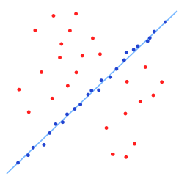
Example: 2D Line Fitting
Guess & Verify
1st sample
Return best sample
after ‘k’ guesses
Initial 2D point set
n₀ = Confidence level (IE 95%)
ε = Inlier ratio = #inliers/#outliers, unknown ahead of time
m = # samples to make up model (2D line = 2)

Slide 4
RANSAC: Pros/Cons
Pro: Robust Estimation, given large enough ‘k’
Returns very good solution
Robust to having lots of outliers in data set
Con: Very slow
process ‘n’ points, ‘k’ times
‘k’ can be very large
‘k’ grows based on ‘m’ number of sample points for model
‘k’ grows based on inlier ratio (lots of outliers -> large k)
Have to use approximate 2*k samples in practice to get good results

Slide 5
How do we speed up RANSAC? Survey of Techniques
Improve Guessing
PROSAC, Chum & Matas
sort points by fitness test, weight sampling towards good points
MLESAC, by Torr et al
Maximum likelihood Estimation, guided sampling
Lo-RANSAC, Chum et al, locally optimal
Once a good sample is found, randomly generate ‘j’ new samples only from inliers of good sample
Improve Verification
T_{d,d} test, by Matas & Chum, test against small set 1st
“Bail out” test, by Capel, confidence testing per point, early exit
“WaldSAC” by Matas & Chum
Uses Wald’s theory of sequential decision making
Optimal if ε-ratio is known ahead of time.

Slide 6
Real-Time Solutions
Pre-emptive RANSAC, by Nister
Fixed amount of time to devote to guessing & checking samples
Divide sample set into ‘s’ blocks of 100 data points each
Divide and conquer,
Generate 500 samples, test against 1 block each
Take best 250 samples, repeat until 1 winner.
RANSAC = Depth First Search
Preemptive = Breadth First

Slide 7
Adaptive Real-Time RANSAC
Take best ideas from other approaches in survey
Based on Pre-emptive framework, only test at most ‘M’ samples (blocks) overall
Partially Depth-First algorithm
Initialize, generate ‘d’ samples, compute initial ε-ratio and ‘k’ from ε-ratio.
Test ‘k samples
Test each of k samples against only 1 block
Bad samples, use early bail-out tests
Re-order samples by ε-ratio, only keep good sub-set
Recompute ε-ratio and ‘k’
If total tests less than ‘M’, generate more inner samples from good samples

Slide 8
Results

Slide 9
Leverage for TMV group
Object Discovery
Line fitting (2 sample points)
Edges between 2 planes (roof meets wall, wall meets floor)
Plane fitting (3 sample points) of grid cells
walls, roofs, curbs, streets, etc.
Quadratic Fitting (6 sample points) of grid cells
Spheres/Ellipsoids => Domes, possible deciduous trees
Vertical Cylinders -> Pipes, poles, HVAC, Water Towers, tree trunks
Horizontal Cylinders -> Wires
Cones -> HVAC, possible coniferous trees,
Replace Inliers by discovered objects
Iterate on Outliers

Slide 10
Questions?

Slide 11
Multidimensional Adaptive Sampling and Reconstruction for Ray Tracing
By
Toshiya Hachisuka, Wojciech Jarosz, Richard Peter Weistroffery, Kevin Dale,
Greg Humphrey, Matthias Zwicker, and Henrik Wann Jensen

Slide 12
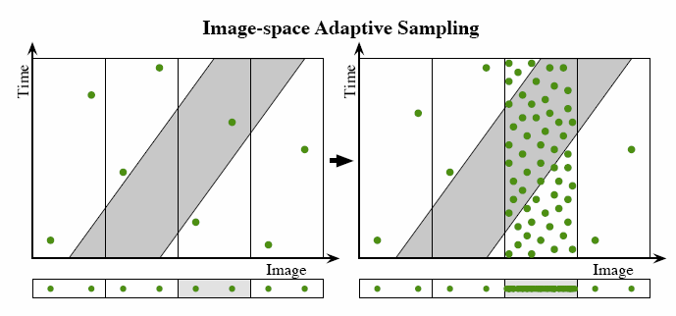
Adaptive Sampling
A 2D example defined by a 1-D image and time.
Image space adaptive sampling collapse the multidimensional function onto the image before detecting discontinuities.

Slide 13
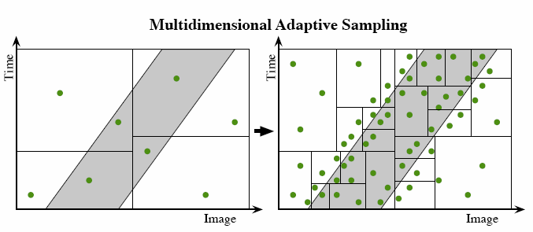
Multi-dimensional Sampling
The new approach detects discontinuities in the multidimensional domain, adapting to the behavior of the full multidimensional function

Slide 14
Formulation:
Based on Kajiya’s original seminal paper
Radiance:
Approximate Integration by splitting up the sampling domain into disjoint sub-domains
Then assume transfer function f is constant across each sub-domain
Riemann Sum
Where V_{Ω} = Volume of sub-domain,
f_{Ω} = constant function approximation across sub-domain

Slide 15
Adaptive Refinement Sampling Algorithm:
Initial coarse sampling of points across nD-space
Uses uniform random distribution
Generate KD-tree from initial samples
Points stored only in leaf nodes, At most, 4 points per leaf
Set error estimates for each node, store in priority queue
Add samples until desired # of samples reached
Grab top node from priority queue
Generate several points, pick & add best-candidate point
Split kd-node, if leaf size exceeded
Update error metrics & priority queue for changed nodes

Slide 16
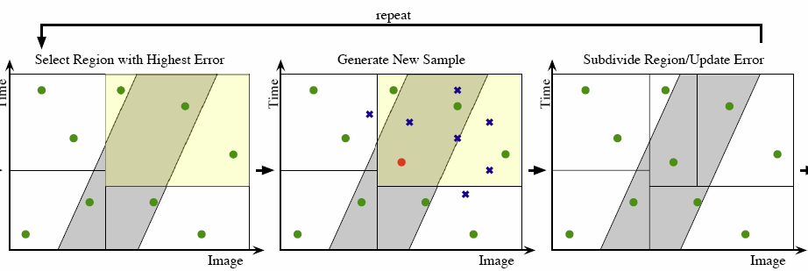
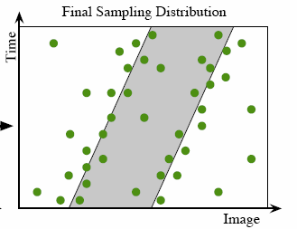
Conceptual Algorithm
Note: Samples
generated
in bounding
sphere
of KD-Node

Slide 17
Error Metrics
Total Error Integral:
Total Error:
V_{j} = volume of kd-tree node,
n_{j} = # of samples in kd-tree node
f(s) = computed sample value from ray tracing
= average sample value in kd-tree node
Error Function:

Slide 18
Reconstruction Ideas
Create 2D image from evaluated samples
Should be a good discrete fit to underlying continuous multi-dimensional function
Motion Blur, Depth of Field, and other distributed ray-tracing effects generate highly anisotropic effects in multi-dimensions
A pool table with moving balls = 4 dimension (x,y,z+time)
A Stationary ball looks like a static extrusion along time dimension
A Moving ball looks like a sheared extrusion of the x,y,z extent thru time dimension.

Slide 19
How do we handle anisotropy?
Use a distorted distance metric
Stretches area of influence along edges (Blurs)
Contracts area of influence across discontinuities (preserve sharp features)

Slide 20
Compute Anisotropy, part I
Subdivide KD-tree (Until each leaf contains only 1 point)
Estimate gradient for each sample point
Perform kNN lookup for each point (k=12)
Solve over constrained gradient equations via LLS
Compute Structure Tensor G for each sample
A dxd matrix for d-dimensional space
G specifies a general ellipsoid, eigenvectors correspond to ellipsoid axes, longest axis is oriented in direction of greatest stetch (IE captures anisotropy)
Use Structure Tensor to compute Mahalanobis distances in Reconstruction

Slide 21
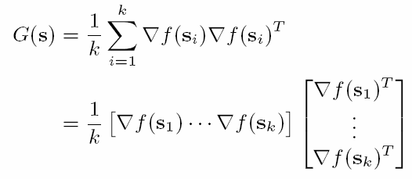
Anisotropy, Part II
Gradient Equations:
Structure Tensor G:
Mahalanobis Distance:
v = difference vector (x-s)
s = sample point
x = point to compute distance for
∑ = covariance matrix of points in local region
G = structure tensor in local region

Slide 22
Anisotropy, Part III

Slide 23
Nearest Neighbor Function Reconstruction
For a desired reconstruction point p, find k nearest neighbors (k = 12) in KD-tree.
Note: Use normal distance metric for this search.
Reason: Robust to rapidly changing densities
Find Closest point
Use the structure tensor G associated with each sample point to compute the Mahalanobis distances from p to each of it’s k neighbors.
Choose the closest point x’ under this metric.
Use the function value f(x’) associated with the point x’ as the function reconstruction for p.

Slide 24
Reconstruction Integration
For each pixel in image
Partition sample domain into disjoint sub-regions
Overlap KD-tree and Image grid column
The # of sub-regions for a pixel column (x,y) is equal to the number of KD-tree regions which span that pixel column
Compute volume for each sub-region
Compute f_{Ω} at the centroid of each sub-region using nearest neighbor interpolation as described in previous slide
Compute Radiance for each pixel as the Riemann sum of of the product of sub-regions volume and sample evaluation (L(x,y)=∑ v_{Ω} f_{Ω} ).

Slide 25
Reconstruction Integration, Part II

Slide 26
Results, part I

Slide 27
Results, Part II

Slide 28
Results, Part III

Slide 29
Limitations
May miss small features
May fail to subdivide nodes properly if all member samples just happen to have same radiance result
May miss illumination coming thru a gap (door crack)
Note quite the same as a Monte Carlo method
Uses Riemann sums, not probability density functions for integration
High Dimensions
KD-Tree has poor performance for high dimensions
Curse of Dimensionality
Non-uniform dimension scaling
Different units on different dimensions
Scaling factors on dimensions directly impact quality of results

Slide 30
Leverage for TMV, part I
Use sampling algorithm for compression directly on original point cloud (without need to mesh)
Snap random sample points to closest actual point in point cloud
Replace ray tracing radiance function f in error function by something better suited to terrain
Plane (or Quadratic) fitness tests
Height Differences
Gradient
Normal calculation,
QEM, etc.

Slide 31
Leverage for TMV, part II
Adapt concepts from reconstruction for building meshes from point clouds (IE 2.5d Delaunay)
Compute Gradients per point
Compute structure tensors per point
Try using Mahalanobis distance metric
for computing good/bad fits of candidate points into existing component meshes
Projecting candidate points onto local component?

Slide 32
Questions?
Thank you

